Slide 1

DRUG SUPPLY CHAIN MANAGEMENT SYSTEM
Developed By – Group 8
Andrea Sequeria - 002619793
Bhagyashri Chavan -002939515
Rutuja Patil - 002728420

Slide 2
PROBLEM STATEMENT:
The drug supply chain involves the procurement, transportation, storage, and distribution of pharmaceutical products. Due to the critical nature of these products, it is crucial to maintain their quality and safety throughout the supply chain. However, there are several challenges in managing the drug supply chain, such as counterfeit drugs, drug shortages, supply chain disruptions, and inadequate visibility into the supply chain.

Slide 3
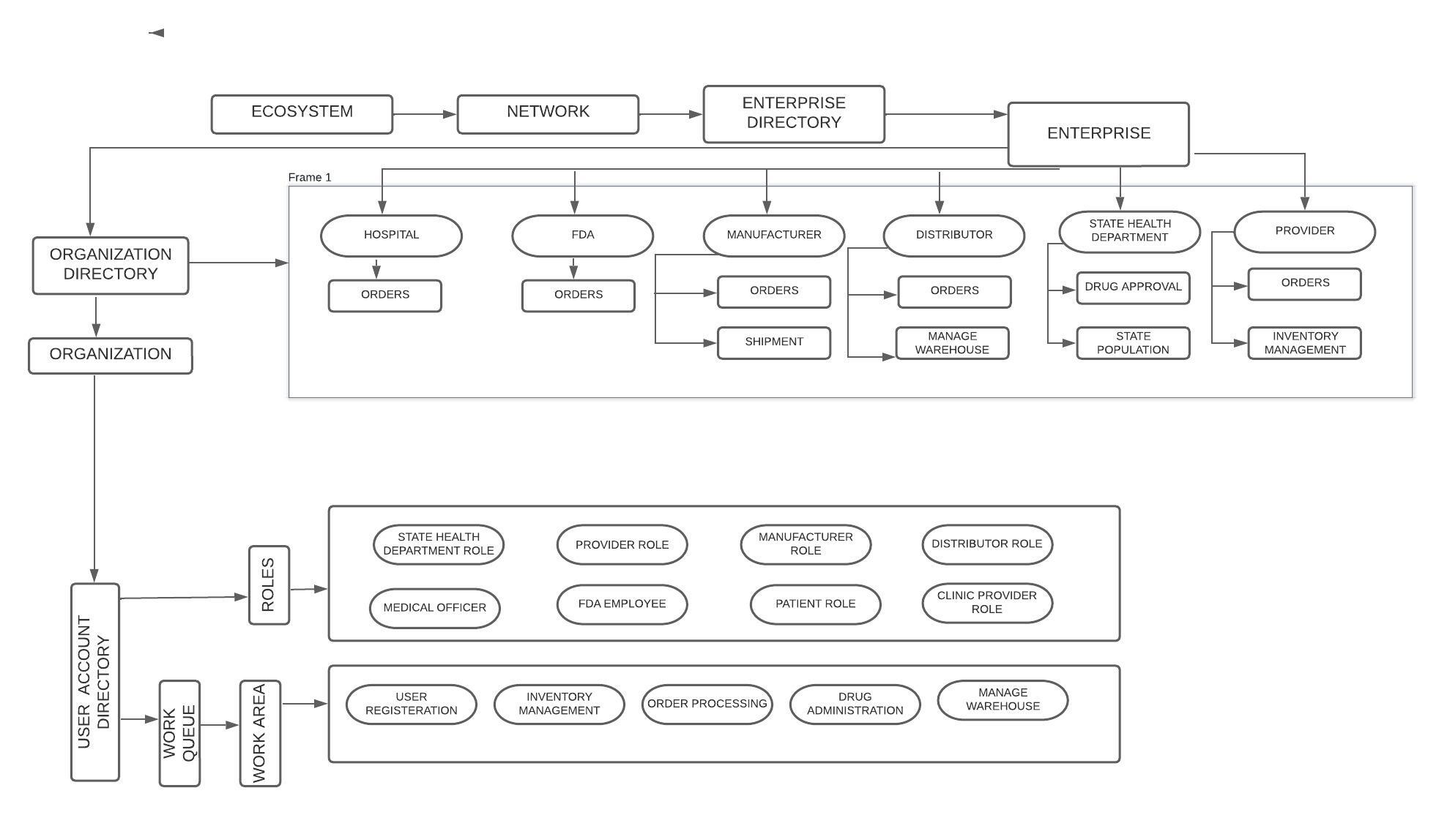
Design:

Slide 4
Contributions:
Andrea Sequeria:
FDA enterprise, Enterprise Admin, State Health Department Enterprise, Validations, Integration with Java Classes.
Bhagyashri Chavan:
System Admin panels, Distributor enterprise, Clinic enterprise, Mail feature, Integration with Java Classes.
Rutuja Patil:
Manufacturer enterprise, Dashboards, Patient enterprise, Provider enterprise, Integration with Java Classes.

Slide 5
Enterprise functionality:
Hospital/Doctor – Place the request for medicine, stores the medicine in hospital inventory after approval & delivery of drugs, Administers patient for immunization.
State Health Department – Adds state population & approves medicine order request.
FDA – orders medicine & approves medicine order request.
Manufacturer – accepts the order for medicines, assigns the orders to self & processes the orders.
Distributors – Ships the orders & manages inventory of the warehouse.
Providers – provides medicines to hospitals/doctors and completes the orders.

Slide 6
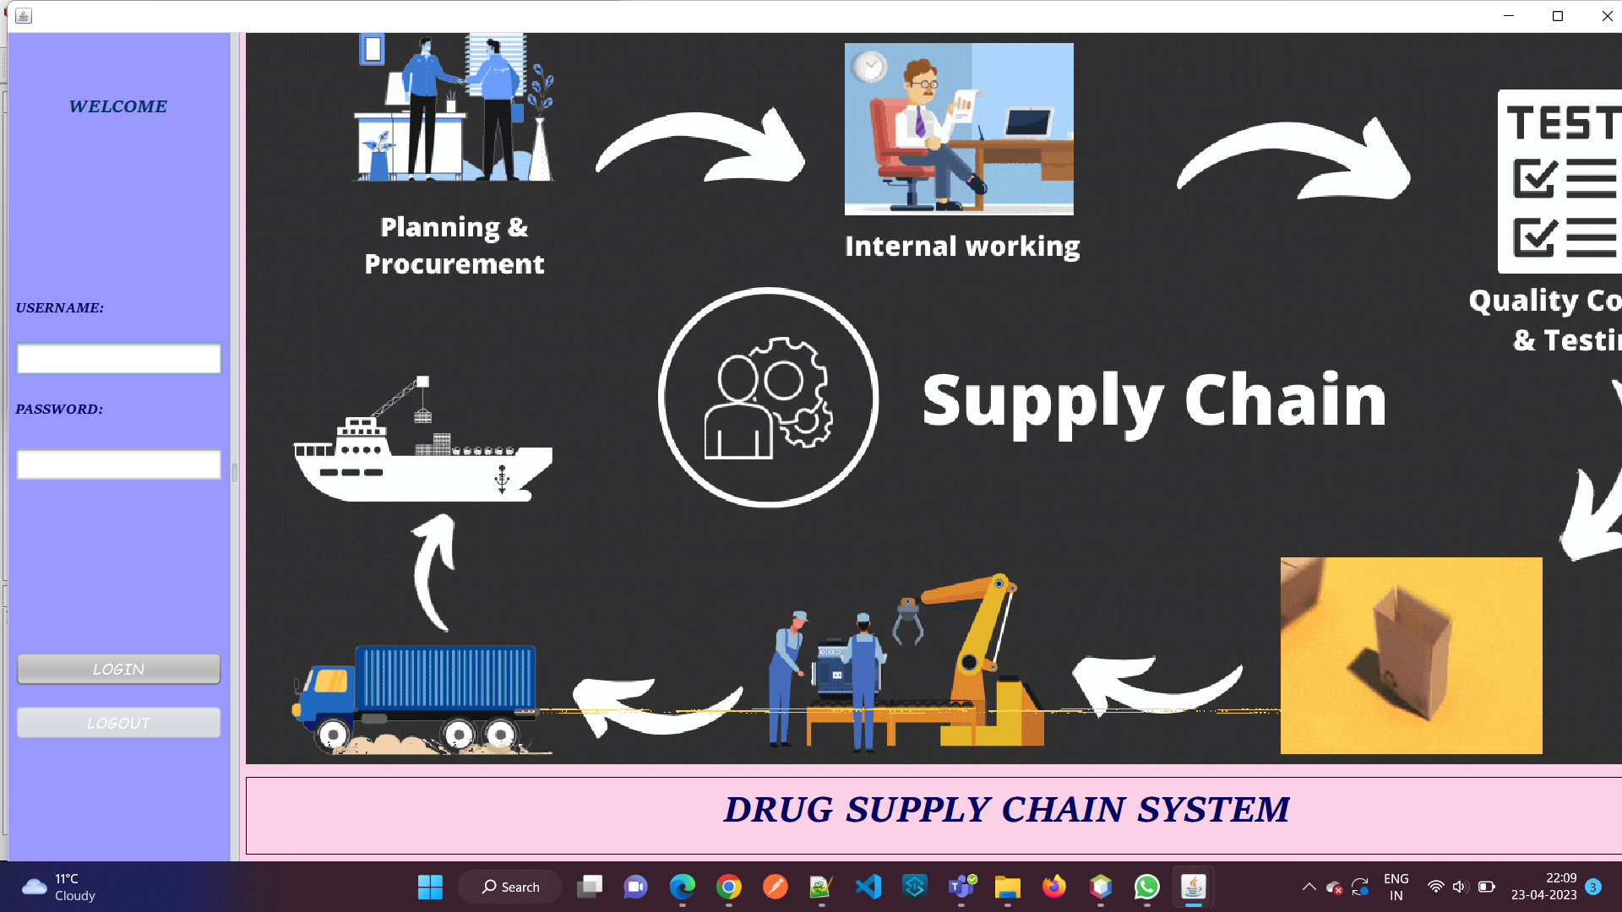

Slide 7
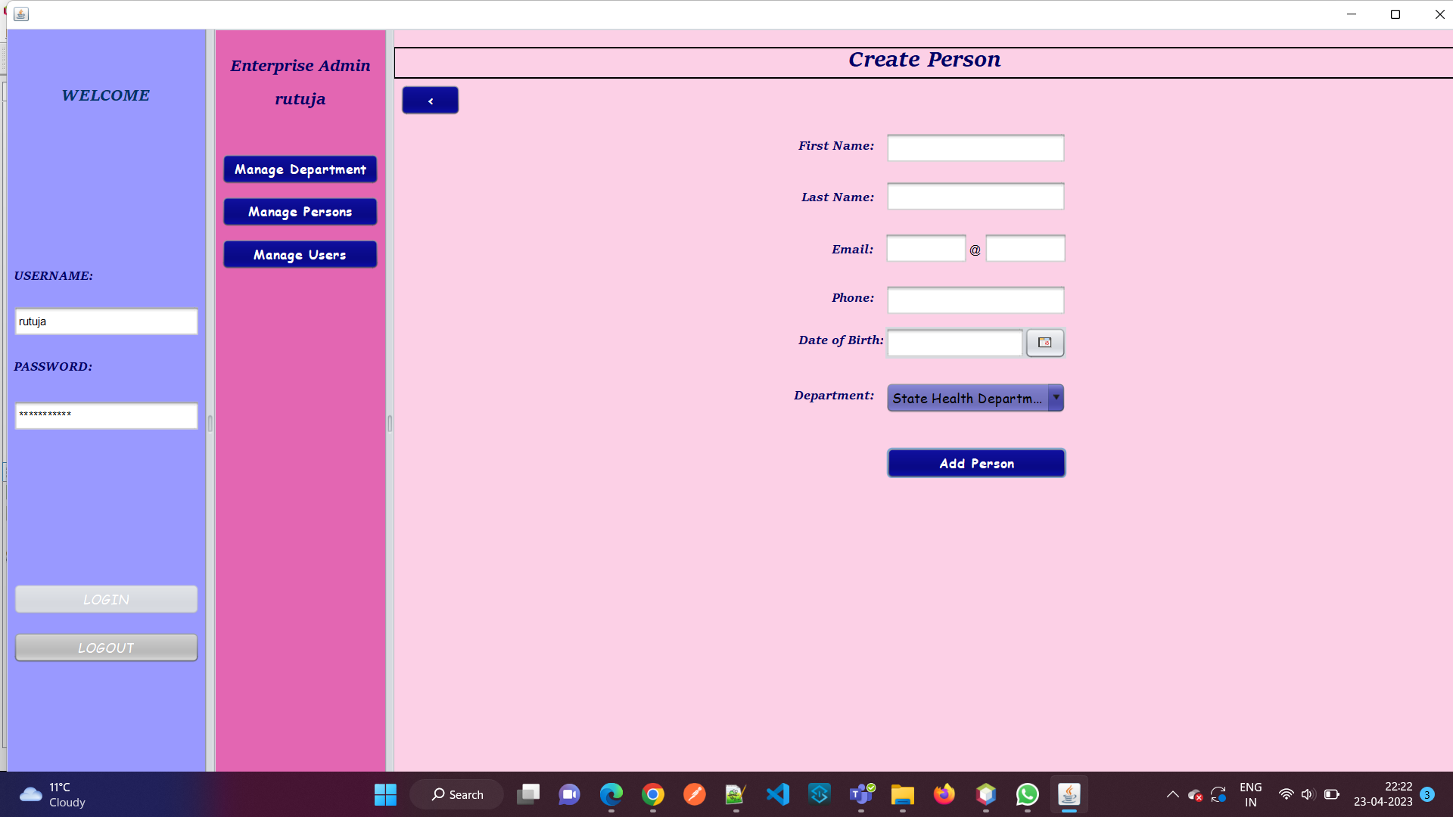

Slide 8
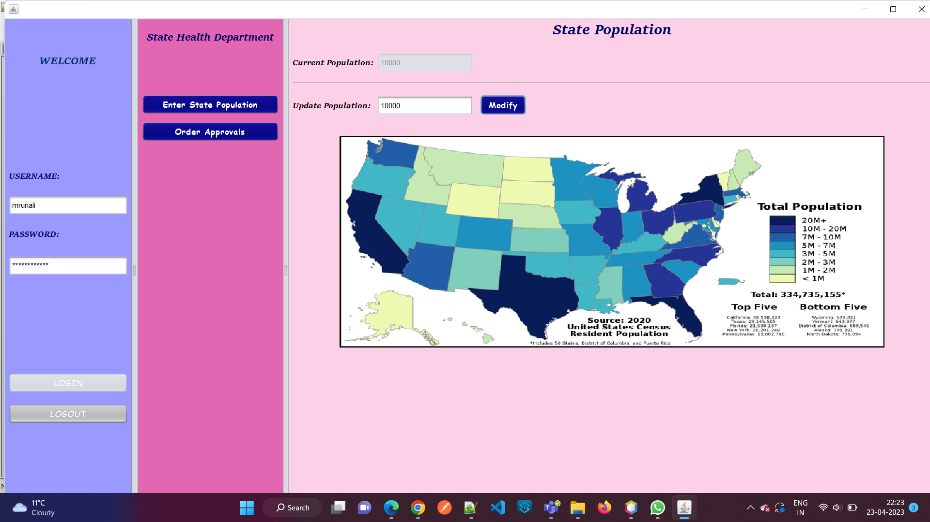

Slide 9
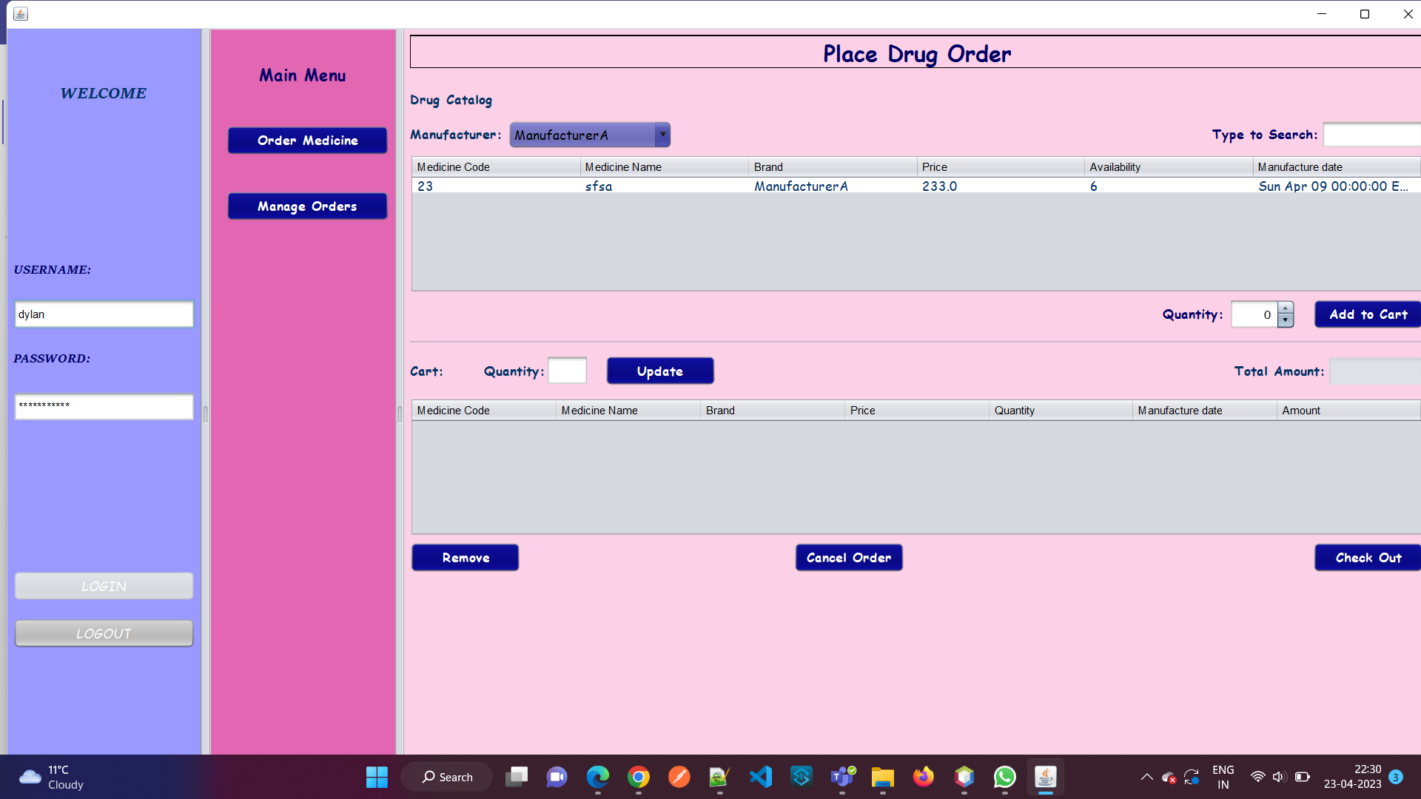

Slide 10
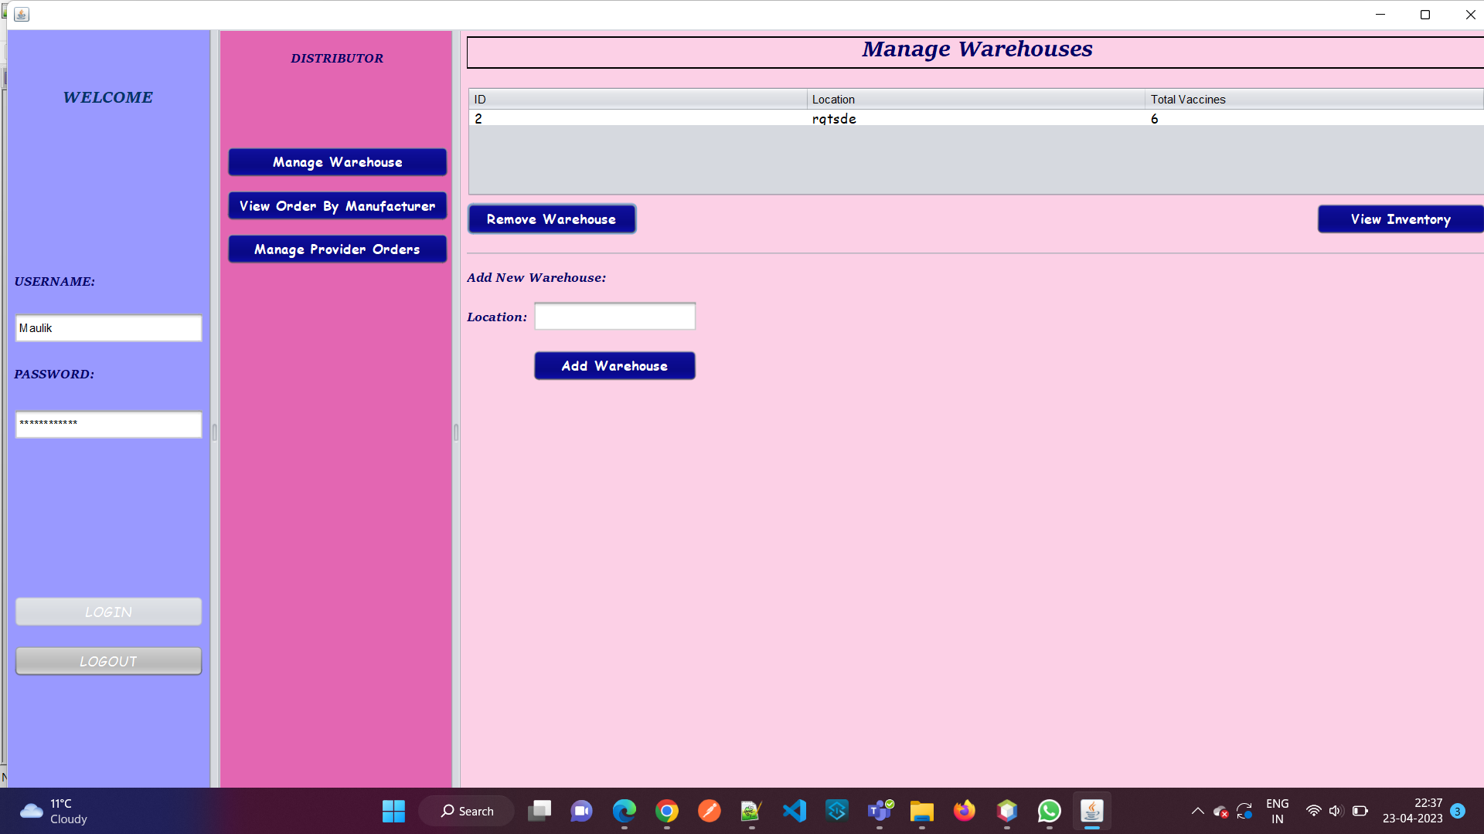

Slide 11
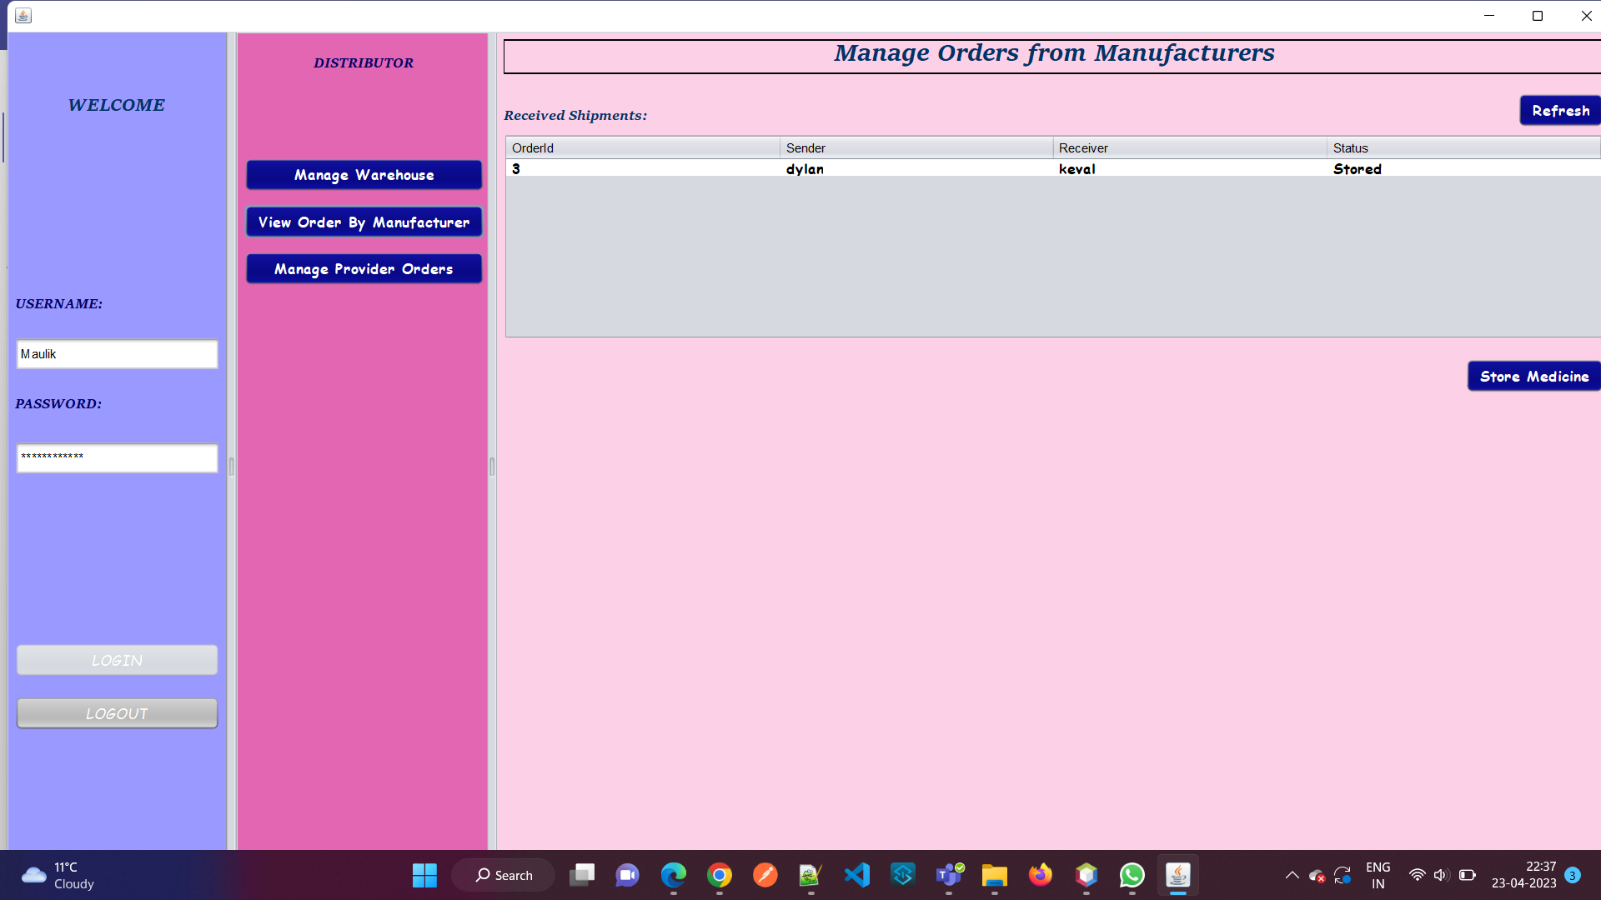

Slide 12
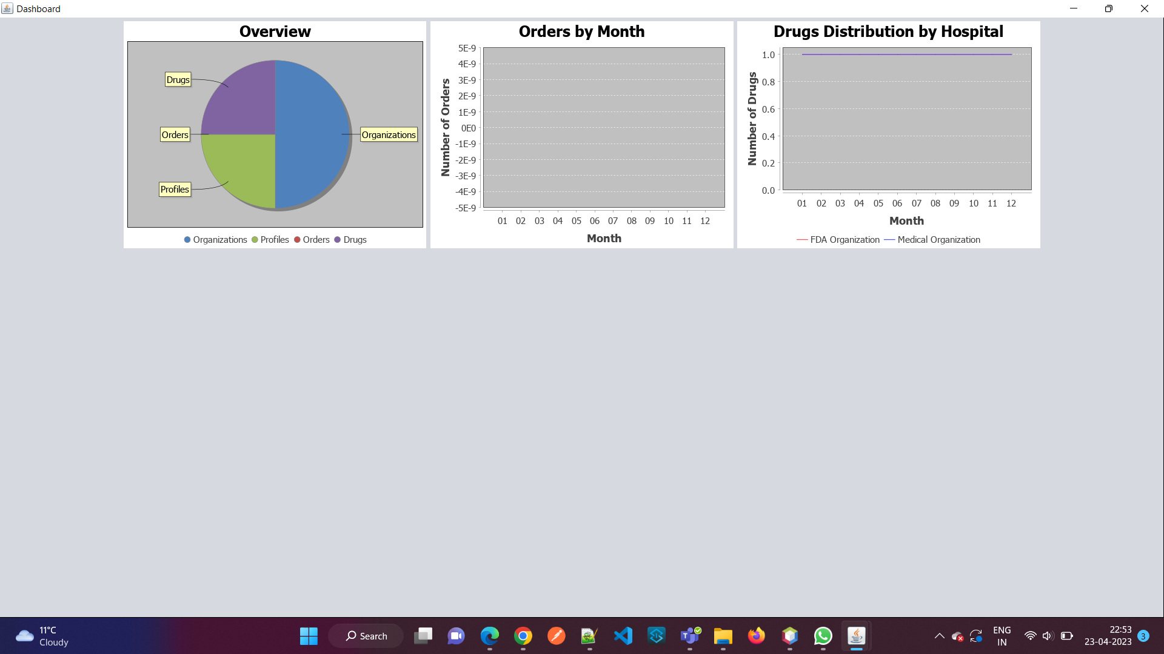

Slide 13
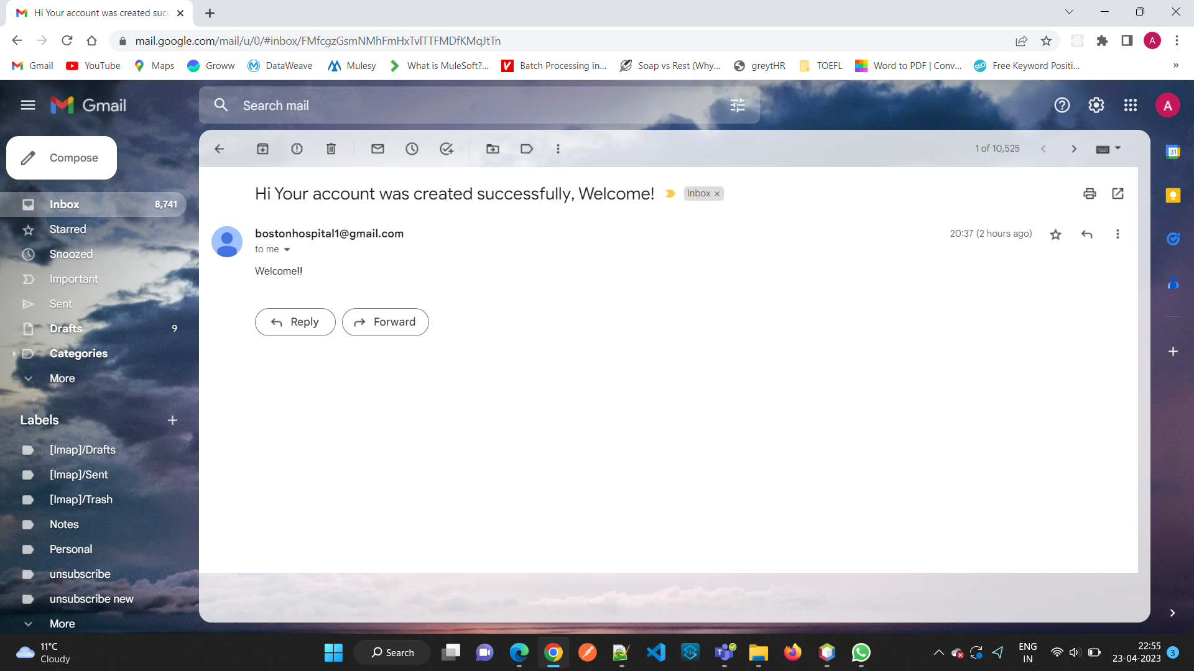

Slide 14
THANK YOU!

